Slide 1
Dot NET 1.0 Essentials
25-Apr-18
Appendix
Online

Slide 2
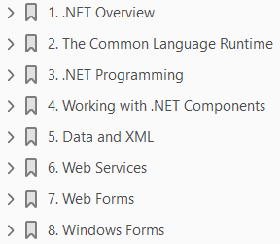
1
2
3
4
5
6
7
8
.NET Framework Essentials 02 2002

Slide 3
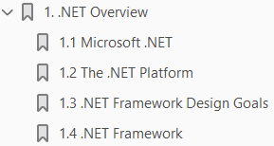
1
.NET Overview

Slide 4
Intro
Microsoft announced the .NET initiative in July 2000.
The .NET platform is a new development framework with a new programming interface to Windows services and APIs, integrating a number of technologies that emerged from Microsoft during the late 1990s.
Incorporated into .NET are
COM+ component services;
the ASP web development framework;
a commitment to XML and object-oriented design;
support for new web services protocols such as SOAP, WSDL, and UDDI;
a focus on the Internet
The platform consists of four separate product groups:
Development tools
Specialized servers
Web services
Devices

Slide 5
Product Groups
The platform consists of four separate product groups:
Development tools - A set of languages, including C# and VB.NET; a set of development tools, including Visual Studio.NET; a comprehensive class library for building web services and web and Windows applications; as well as the Common Language Runtime to execute objects built within this framework.
Specialized servers - A set of .NET Enterprise Servers, formerly known as SQL Server 2000, Exchange 2000, BizTalk 2000, and so on, that provide specialized functionality for relational data storage, email, and B2B commerce.
Web services - An offering of commercial web services, recently announced as project HailStorm; for a fee, developers can use these services in building applications that require knowledge of user identity.
Devices - New .NET-enabled non-PC devices, from cell phones to game boxes. Microsoft is devoting considerable resources to the development and success of .NET and related technologies: their bets are on .NET as the next big thing in computing.

Slide 6
Microsoft .NET
Microsoft has spent the last four years creating Microsoft .NET, which was publicly launched at PDC 2000 in Orlando, Florida.
While the main strategy of .NET is to enable software as a service, .NET is much more than that.
Aside from embracing the Web, Microsoft .NET acknowledges and responds to the following trends within the software industry today:
Distributed computing Componentization
Enterprise services Web paradigm shifts
Maturity factors
Although these are the main concepts that Microsoft .NET incorporates, what's more notable is that Microsoft .NET uses open Internet standards (HTTP, XML, and SOAP) at its core to transmit an object from one machine to another across the Internet.
In fact, there is bidirectional mapping between XML and objects in .NET.
For example, a class can be expressed as an XML Schema Definition (XSD); an object can be converted to and from an XML buffer; a method can be specified using an XML format called Web Services Description Language (WSDL); and an invocation (method call) can be expressed using an XML format called SOAP.

Slide 7
Trends in Software Industry
Microsoft .NET acknowledges and responds to the following trends within the software industry today:
Distributed computing - Simplifies the development of robust client/server applications.
Current distributed technologies require high vendor-affinity and lack interoperation with the Web.
Microsoft .NET provides a remoting architecture that exploits open Internet standards, including the Hypertext Transfer Protocol (HTTP), Extensible Markup Language (XML), and Simple Object Access Protocol (SOAP).
Componentization - Simplifies the integration of software components developed by different vendors.
The Component Object Model (COM) has brought reality to software plug-and-play, but COM component development and deployment are too complex.
Microsoft .NET provides a simpler way to build and deploy components.
Enterprise services - Allow the development of scalable enterprise applications without writing code to manage transactions, security, or pooling.
Microsoft .NET continues to support enterprise services, since these services greatly reduce the development time and effort involved in building large-scale applications.

Slide 8
Trends in Software Industry |
Web paradigm shifts - Represents changes in web technologies to simplify the development of web applications.
Over the last few years, web application development has shifted from connectivity (TCP/IP), to presentation (HTML), to programmability (XML and SOAP).
A key goal of Microsoft .NET is to enable software to be sold and distributed as a service.
Maturity factors - Represents lessons that the software industry has learned from developing large-scale enterprise and web applications.
A commercial web application must support interoperability, scalability, availability, and manageability.
Microsoft .NET facilitates all these goals.

Slide 9
The .NET Platform
The Microsoft .NET Platform consists of five main components, as shown in Figure 1-1.
At the lowest layer lies the operating system (OS), which can be one of a variety of Windows platforms, including Windows XP, Windows 2000, Windows Me, and Windows CE.
As part of the .NET strategy, Microsoft has promised to deliver more .NET device software to facilitate a new generation of smart devices.

Slide 10
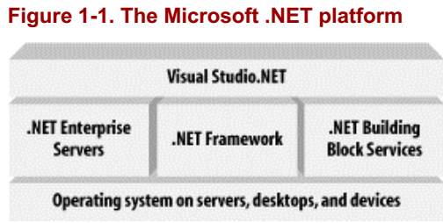
Figure 1-1

Slide 11
.NET Framework Design Goals

Slide 12
Component Infrastructure

Slide 13
Language Integration

Slide 14
Internet Interoperation

Slide 15
Simple Development

Slide 16
Simple Deployment

Slide 17
Reliability

Slide 18
Security

Slide 19
.NET Framework

Slide 20
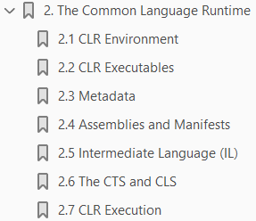
2
The CLR

Slide 21
Intro

Slide 22
CLR Movement

Slide 23
CLR Executables

Slide 24
Hello, World: Managed C++

Slide 25
Hello, World: Managed C#

Slide 26
Hello, World: VB.NET

Slide 27
.NET Portable Executable File

Slide 28
Metadata

Slide 29
Type Libraries on Steroids

Slide 30
Examining Metadata

Slide 31
Inspecting and Emitting Metadata

Slide 32
Interoperability Support

Slide 33
Assemblies and Manifests

Slide 34
Assemblies Versus Components

Slide 35
Unique Identities

Slide 36
IL Code

Slide 37
Versioning

Slide 38
Deployment

Slide 39
Security

Slide 40
Side-by-side Execution

Slide 41
Sharing and Reuse

Slide 42
Manifests: Assembly Metadata

Slide 43
Creating Assemblies

Slide 44
Using Assemblies

Slide 45
Intermediate Language (IL)

Slide 46
The CTS and CLS

Slide 47
The Common Type System (CTS)

Slide 48
Value types

Slide 49
Reference types

Slide 50
Boxing and unboxing

Slide 51
Classes, properties, indexers

Slide 52
Interfaces

Slide 53
Delegates

Slide 54
The Common Language System (CLS)

Slide 55
CLR Execution

Slide 56
Class Loader

Slide 57
Verifier

Slide 58
JIT Compilers

Slide 59
Execution Support and Management

Slide 60
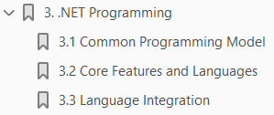
3
.NET Programming

Slide 61
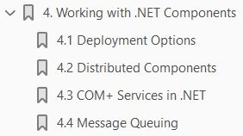
4
Working with .NET Components

Slide 62
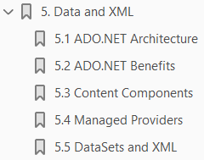
5
Data and XML

Slide 63
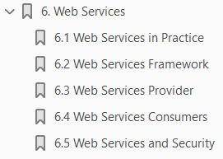
6
Web Services

Slide 64
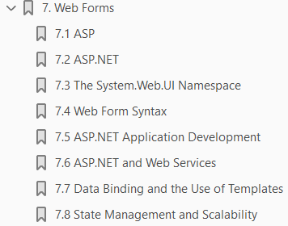
7
Web Forms

